Slide 1

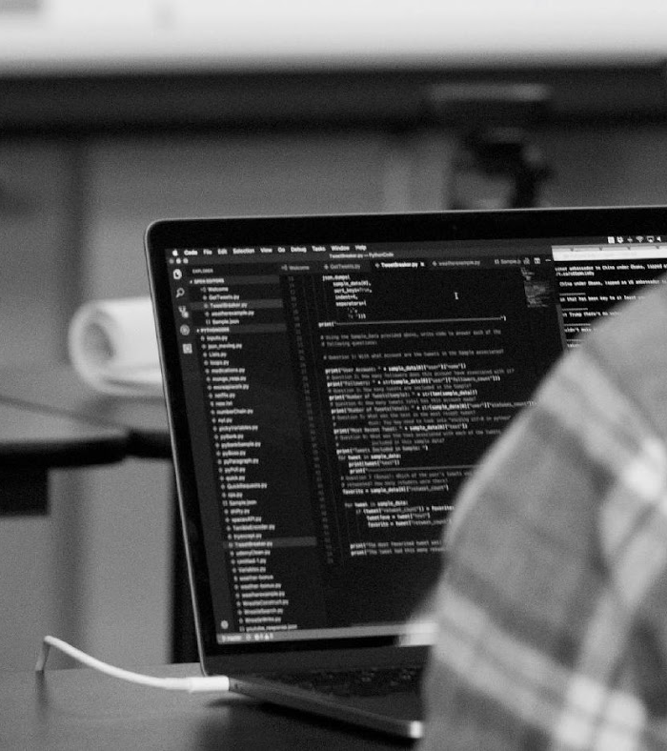

Tackling the Technical Interview Series: Talking Tech
Please mark your attendance with an X on the sheet so that you can get credit for this workshop

Slide 2
Purpose & Objectives
Utilize whiteboarding strategies to tackle a technical interview question.
Understand how to walk through your code in a technical interview with a technical recruiter.

Slide 3
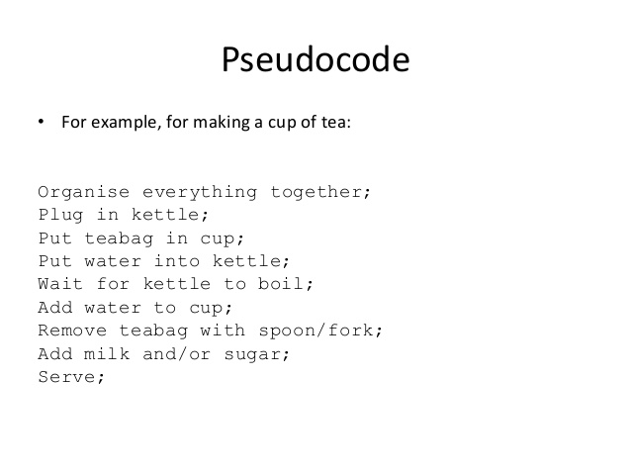
Psuedo Coding
Write out your thought process. This is a good time to brainstorm how you want to build the program.
Do not start coding yet.
Use Keywords like For, While, Array, List.
Don’t be too specific, Don’t be too general.
Make sure that you’ve listed and talked through all possibilities and scenarios.

Slide 4
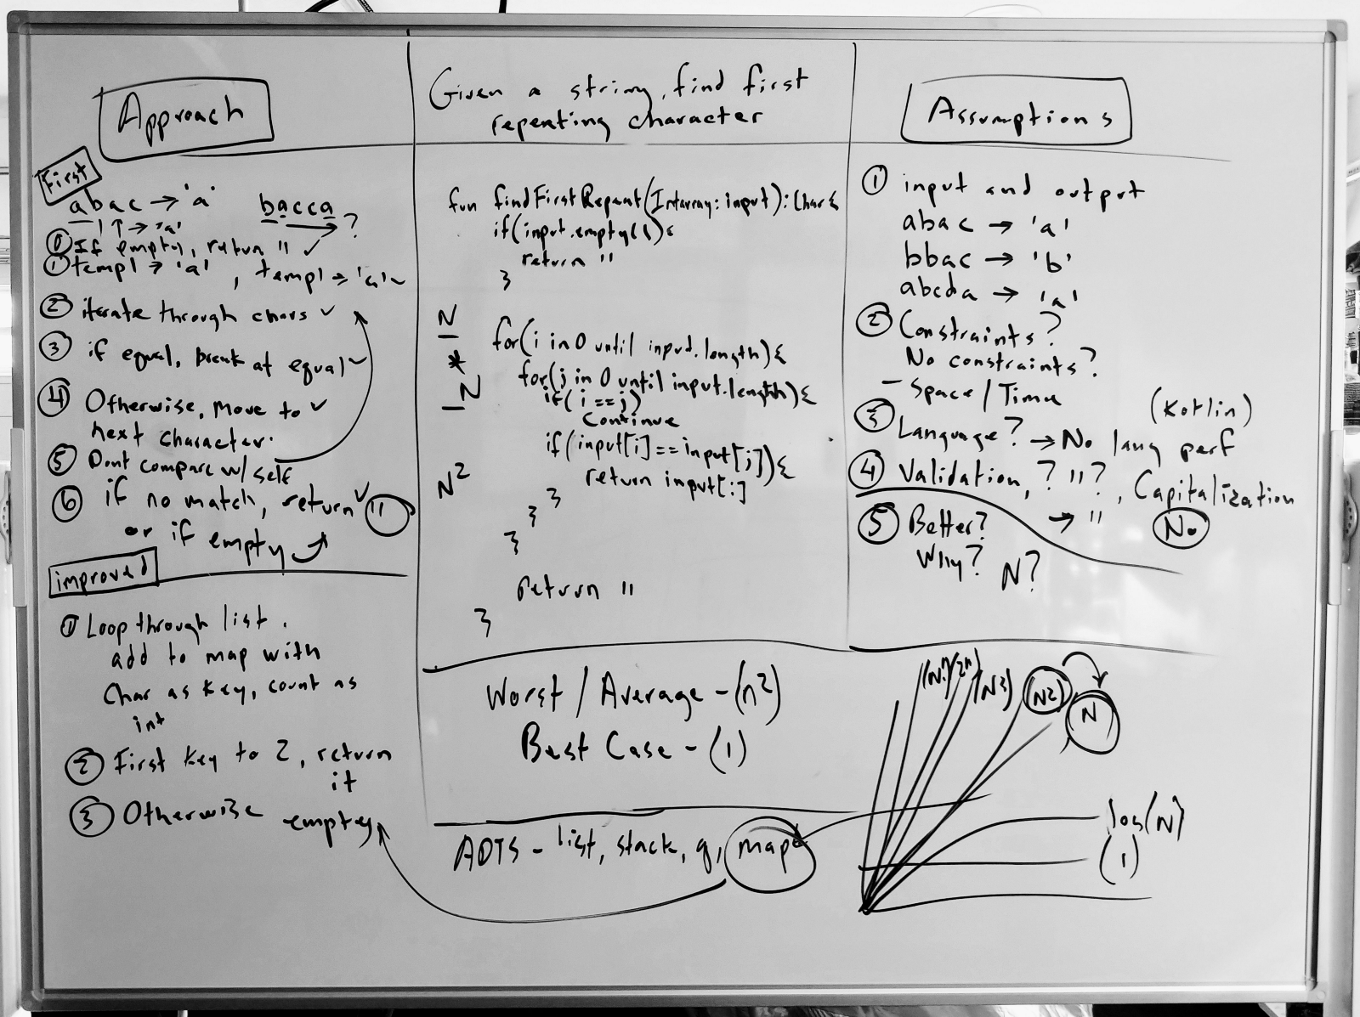
Coding & Optimization
What your whiteboard should look like?
Psuedo Code
Code
Optimization
Test Cases
Notes:
Dashboard: Go over what is the dashboard, and where everything is on the dashboard.
New Button: Go over the new button and how you make a repository and then show the other places where you can make the repository.

Slide 5
Talking About Code

Slide 6
One part of preparing for the technical interview is understanding how to talk about 2 - 3 technical projects that you understand the ins and outs of fully. You want to select projects that match as closely as possible to the following criteria:
The project has challenging components. You were able to grow from building this project and add to your skillset.
You played a huge role in building this project.
You can talk in technical depth about this project.

Slide 7
Common Questions | Project 1 | Project 2 | Project 3
What did you Enjoy?
List challenges that you faced.
What were some mistakes or failures you made / encountered?
Did you engage in leadership opportunities?
How did you overcome conflict?
What would you do differently
Use the Preparation Grid to understand more about your technical projects. These make great talking points for your interview.

Slide 8
Career Services Activity
Ask yourself these questions about the hasDouble exercise.
What did you enjoy?
List challenges that you faced.
What were some mistakes you made/encountered?
How did you overcome conflict?
What would you do differently?

Slide 9

The S.T.A.R Method

Slide 10
Use the S.T.A.R method in answering questions.
Situation: a problem or situation you faced
Task: the task that you had to accomplish to solve the problem
Action: what action did you take to solve the problem
Result: what was the result? Good or bad and what could you have done differently?
Use the Preparation Grid to help guide your answers.
Use the S.T.A.R Method

Slide 11
Career Services Activity
Answer the following Questions:
Tell me about a project where you had to overcome a conflict.
Tell me about a situation during a recent project when you had to adapt and manage change.
Tell me about a project where you realized you were off track and had to course correct.

Slide 12
Pop Quiz!
What are the three steps you need to take in a whiteboarding interview?
When explaining your code to a technical recruiter what is the method that you should use?
If you are unsure of how to answer the technical interviewing question given to you, what step should you rely on?

Slide 13
Q&A

Slide 14


